Slide 1
Weather Desktop App
Musawar Bilal (Fa-18/BSSE/062)
M Haseeb (Fa-18/BSSE/068)

Slide 2

Introduction
Weather forecasting is the application of science and technology to predict the conditions of the atmosphere for a given location and time. We have created a desktop weather forecasting application in which we can forecast the weather conditions of daily and the whole week record of different cities. There is an admin panel through which we can update data and view records stored in the database. The instructions for using the applications were also included.

Slide 3
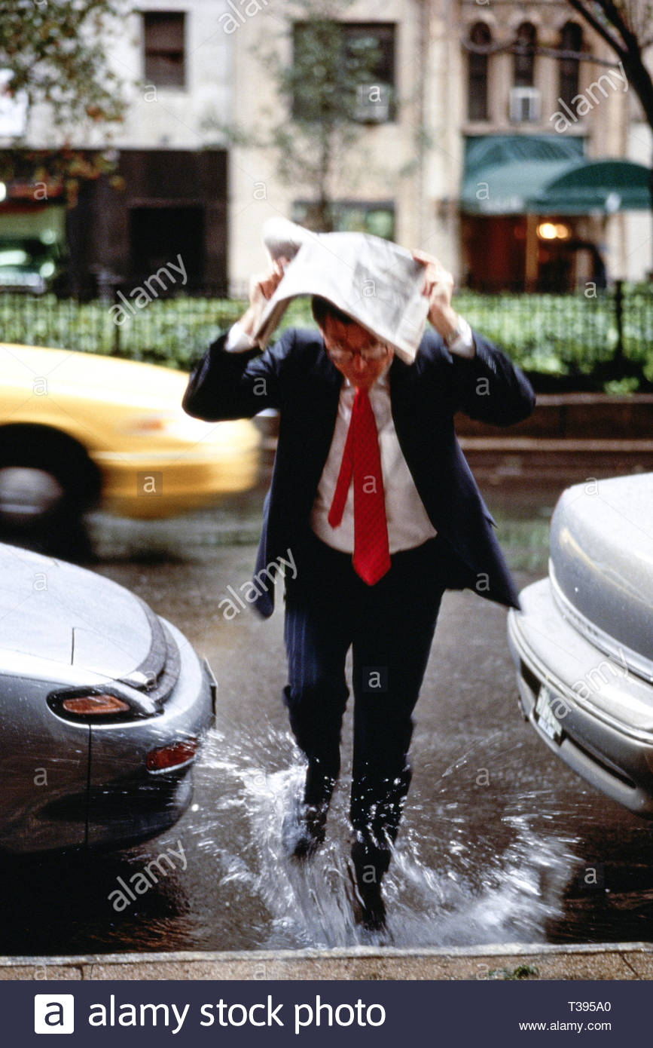
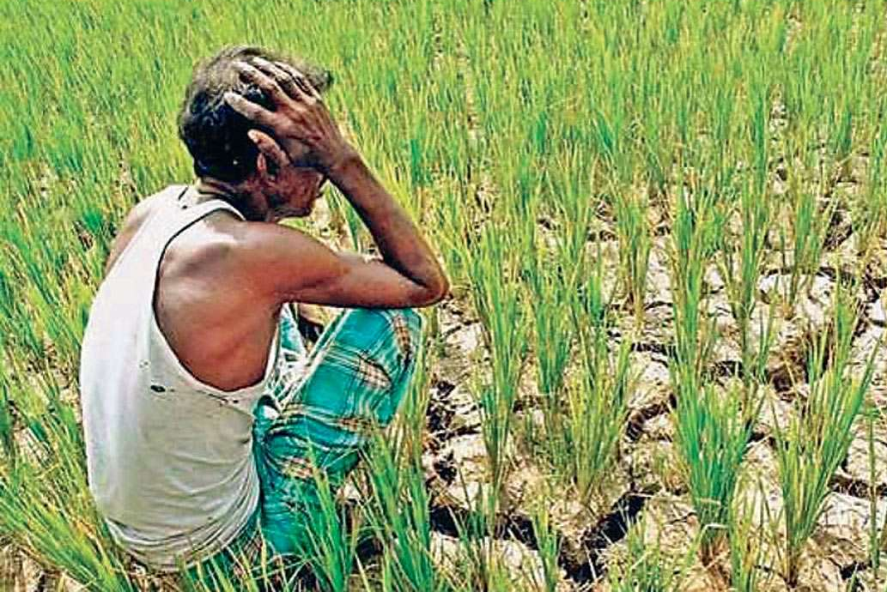
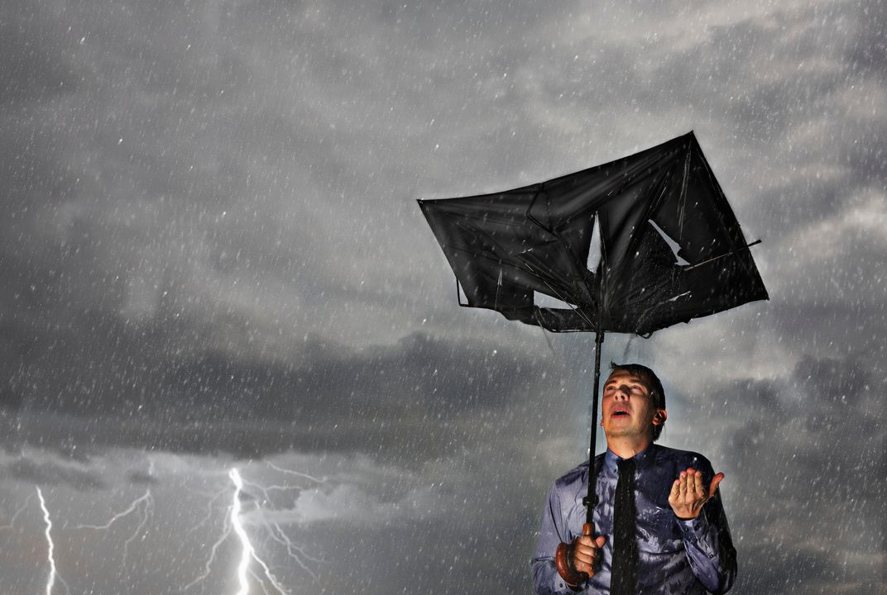
Problem Statement
Weather forecast has become a very important thing as the people around the whole world relays on the weather report. Sometimes Weather conditions changes so quickly that no one could imagine that change so there is a dire need of a platform that will provide the weather updates of every city around the world.

Slide 4

Solutions
The purpose of developing weather app is to fetch the data by entering the city name for taking weather information and also for storing the data in the database. Another purpose for developing this software is to generate the daily as well as weekly report of weather forecast.

Slide 5
Overall Description
User Interface: A first-time user of the Weather forecast should follow the instructions as given in the start of the application. Users can directly access the complete weather conditions of different cities on daily basis and weekly basis.
Operations: The weather desktop application is used to display the weather report of different cities daily and weekly weather conditions. It also enables login feature to admin and provide an admin panel through which admin can update and view records.

Slide 6
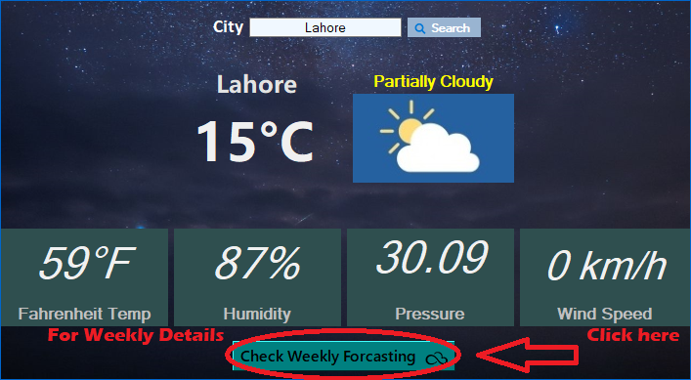
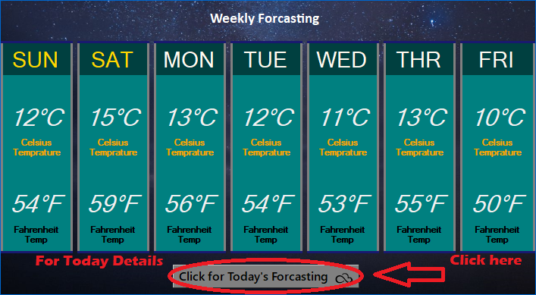
User Characteristics
Users will be provided with the quick instructions for using application.
Users can get complete weather report of different cities.
User will also get information about weekly weather.

Slide 7

Benefits
Improve Operational Efficiency
Useful for Various Weather Operations
Less Efforts in Managing Farming Operations
Easy Availability of Information
Time Saving Application
Economically Feasible for Users

Slide 8
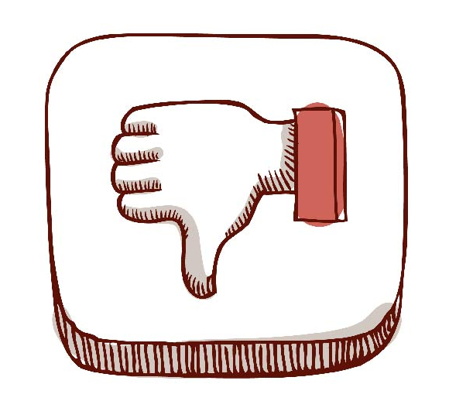
Disadvantages
Weather changes all the time
Not entirely reliable
The estimates can be wrong

Slide 9

Tools
1. Microsoft Visual Studio
2. Microsoft SQL Server
3. Photoshop
4. Paint

Slide 10

Languages
C# (Design and Coding)
SQL (Database Queries)

Slide 11
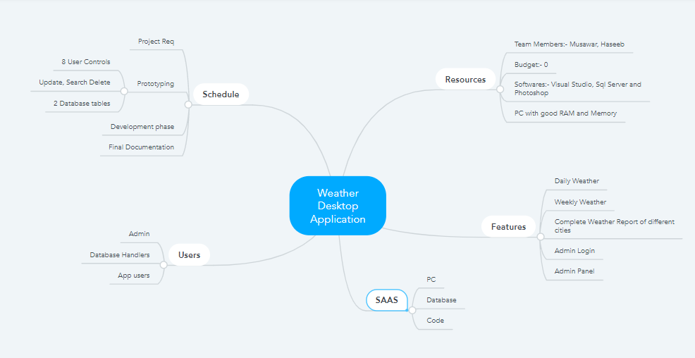
Mind Map
Mind Map

Slide 12
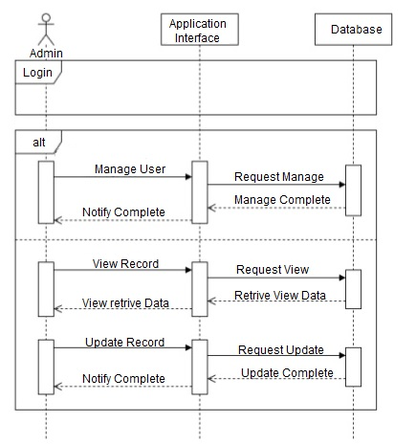

Sequence Diagram:

Slide 13
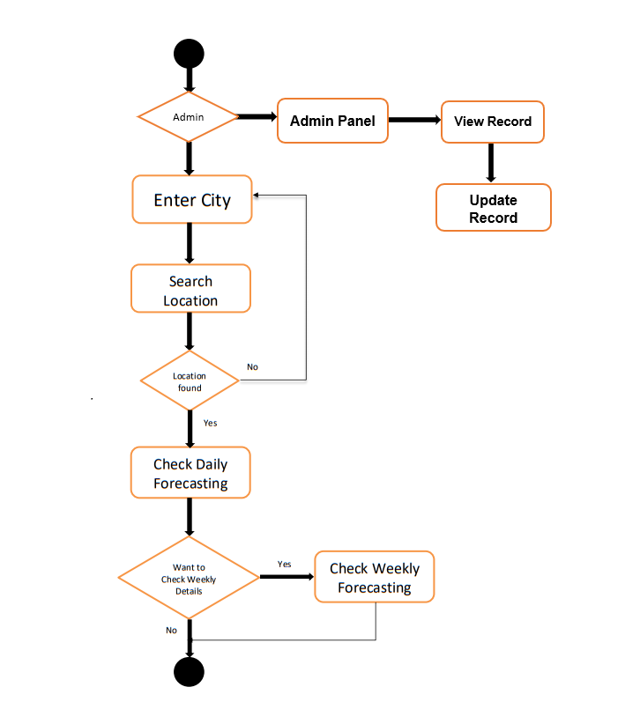
Activity Flow Diagram:

Slide 14

Thank You

